Slide 1
Comparison of Ataxia Telangiectasia Mutated’s nucleotide sequence in different model organisms
-Jaspreet Kaur Rishi
May 3rd, 2021

Slide 2
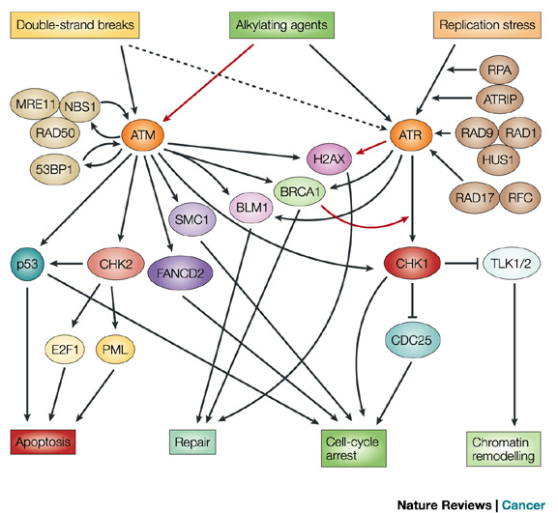
Ataxia Telangiectasia
mutated
Notes:
For DNA damage repair, HR is the pathway of choice for oocytes within primordial follicles and it requires the recognition of DNA DSBs by the MRE2-NSB1-RAD50 complex. NSB1 protein interacts with ATM. ATM autophosphorylates at a serine residue and recruites and phosphorylates H2AX. Which binds at DNA damage sites and controls the recruitement of DNA repair proteins. ATM also phosphorylates another important downstream protein, BRCA1 for DNA Damage repair.
In 1995, the gene was discovered by Dr. Yosef Shiloh^{[5]} who named its product ATM since he found that its mutations are responsible for the disorder ataxia–telangiectasia. In 1998, the Shiloh and Kastan laboratories independently showed that ATM is a protein kinase whose activity is enhanced by DNA damage.[

Slide 3
https://ourworldindata.org/obesity
Notes:
This chart shows distribution of obesity in the United States where obesity is a rising concern. As you can see, Iowa also has a high percentage of obese adults. Infact, about 65% of the World’s population lives in countries where obesity is a bigger concern for morbidity than malnutrition.

Slide 4
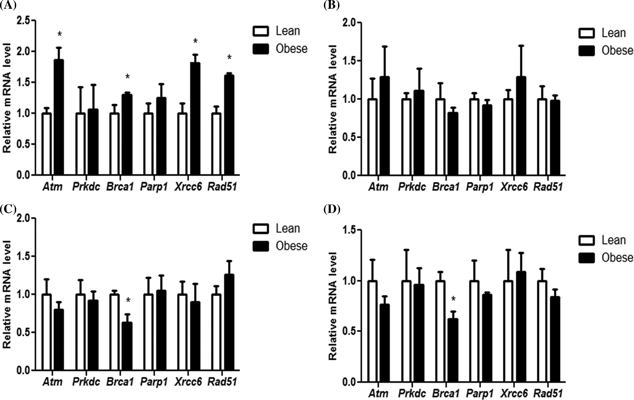
Impact of obesity progression on mRNA abundance of DNA repair genes
6 weeks
12 weeks
18 weeks
24 weeks
Ganesan et al. 2016
Notes:
Previously, our lab has shown obesity progression has an impact on DDR genes. This graph shows relative mRNA levels of 6 genes involved in the DDR pathway in mice starting at 6 weeks of age followed by 12, 18 and 42. ATM mRNA increased at 6 weeks and remains unchanged later on. So the alteration in ATM is only observed before the obesity effects were observed. BRCA1 is increased at 6 weeks but decreased at 18 and 24. So we’re seeing an alteration before the effects of obesity are observed and then the trend is reversed .
Agouti responsible for chem metabolism? But not consistent over the diff time points. 6 weeks- ATM altered – before obesity effect. But overtime, lose that.

Slide 5
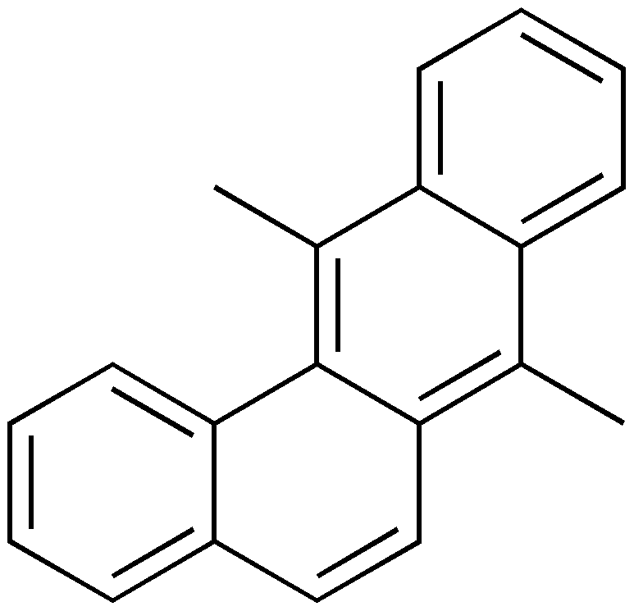
7,12 dimethylbenz anthracene
Notes:
7,12 dimethylbenz anthracene is a polycyclic aromatic hydrocarbon that is released when any organic compounds combust. This includes wildfires, smoking, grilling meat, mining, waste incineration. And it can have effects on fertility.

Slide 6
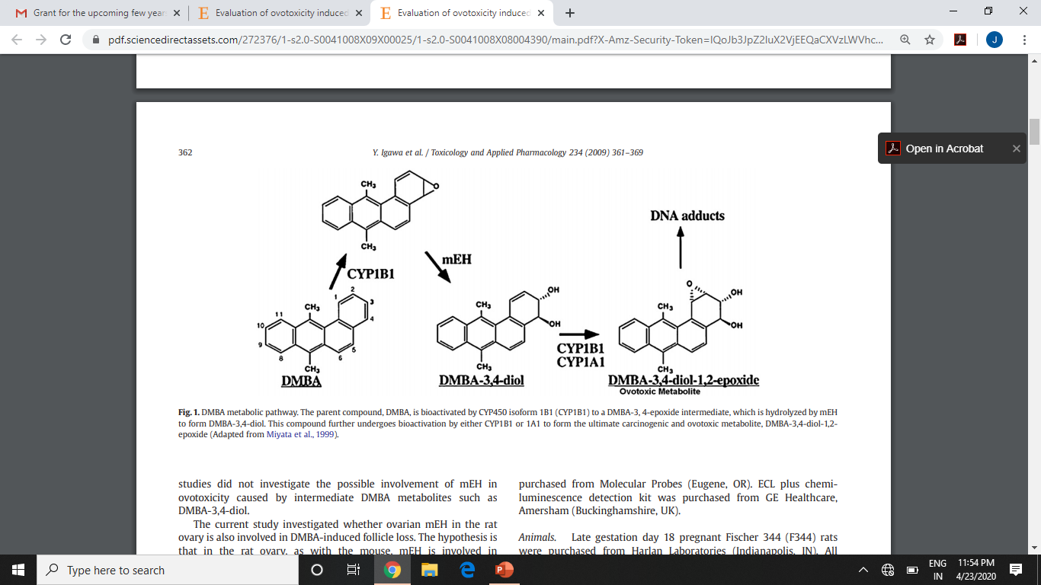
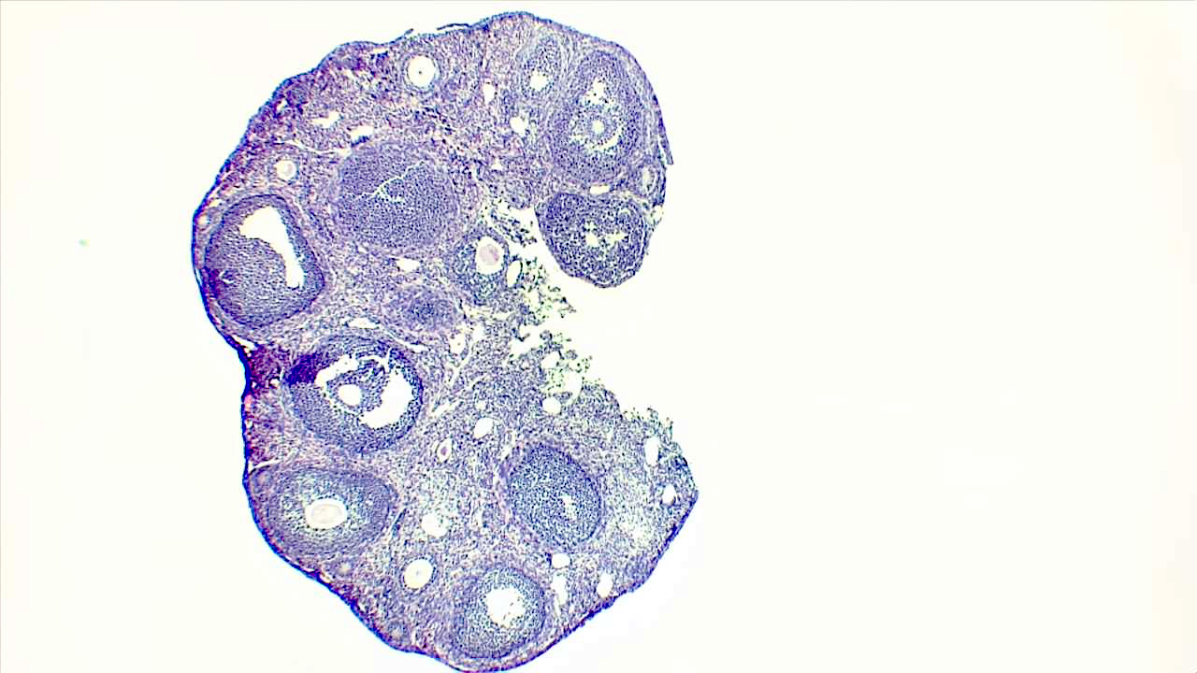
Biotransformation of DMBA
Igawa et al. 2009
Notes:
The ovary biotransforms ovotoxic chemicals into compounds that are lesser or greater ovotoxicants. When DMBA is ingested, it is bioactivated by CYP450 isoform 1B1 to an epoxide intermediate which is hydrolyzed by microsomal epoxide hydrolase and further converted to a genotoxicant epoxide.
Temporary and permanent infertility

Slide 7
Hypothesis
Altered ATM function is a biological consequence of obesity that impacts ovarian sensitivity to genotoxicants.
Notes:
This leads to my hypothesis And in these sets of experiments, we are going to examine the ovaries response to an ovotoxicant in obese vs lean mice.

Slide 8
Aim
Determine whether the results inferred from studying the ATM protein in mice will be translatable to humans by generating a phylogenetic tree of the protein in
different species.

Slide 9
Materials and methods
Sequences from NCBI
Multiple sequence alignment using MAFFT
Maximum likelihood tree using RAXML-ng
Bootstrap analysis
Bayesian analysis for hypothesis testing
Notes:
I used the 10 most commonly used model organisms in labs

Slide 10
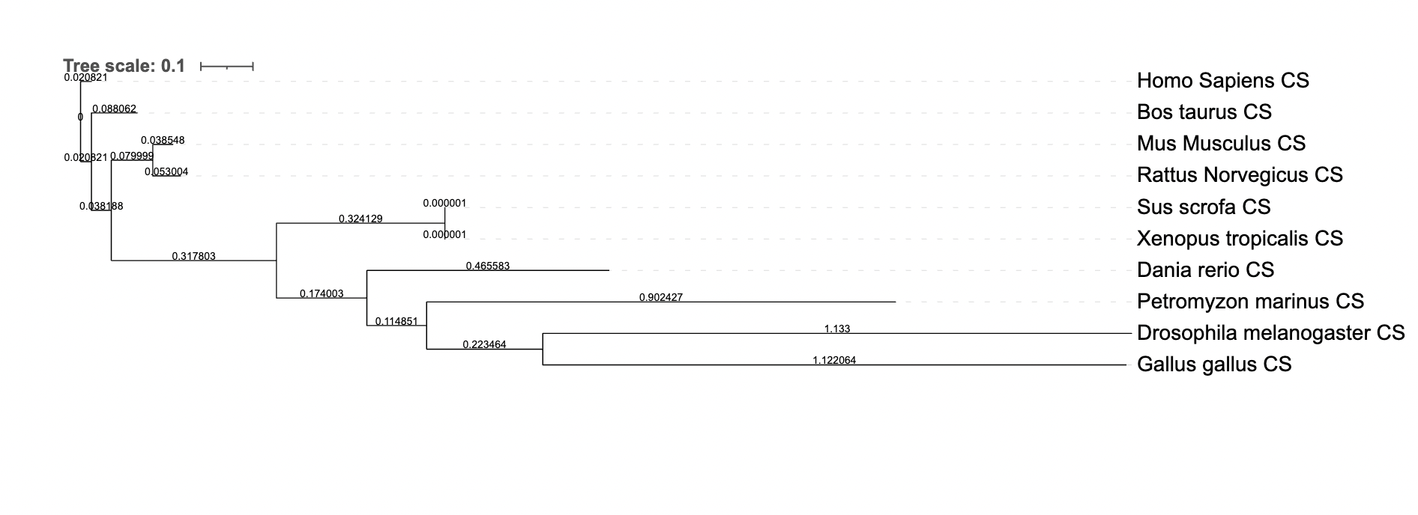
Best tree produced by maximum likelihood.
Notes:
Used Coding sequences of the gene encoding for the ATM protein. MAFFT was used to align the sequences and the seed value was set as 100 for a high reproducibility. Homo sapiens was set as the outgroup to root the tree as I wanted to compare the sequence of ATM in homo sapiens with that of the other species and specifically compare how similar it is to that of mus musculus.The closest sequence of the other 9 species with the atm seq of homo sapiens was of bos taurus, cattle and this was determined by the shortest branch length of 0.088062.
. Interestingly, the next closest leaf of the tree was Mus musculus (mouse) at a length of 0.138868. The next leaf was Rattus norvegicus(rat), followed by Sus scrofa(pig) and so on. The phylogenetic tree generated was not surprising but rather expected as it was reflective of what is also seen when the entire genomes of these species are used to generate a phylogenetic tree¹⁸. Had it been different, it would be indicative of lesser or greater differences in a particular gene sequence, in this case ATM, as a ratio of differences in the entire genome.
From my literatures searches and connections with other ovarian physiology lab groups, cattle, mouse, rats and pigs are the top model organisms to study ovary functions.

Slide 11
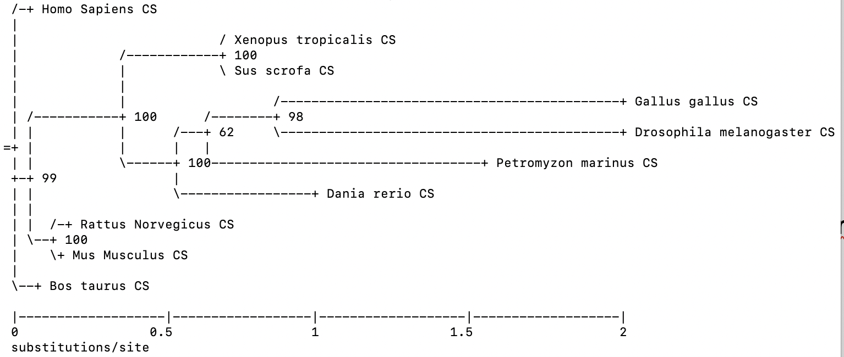
Bootstrap support tree produced by 1000 replicates
Notes:
Next, I ran bootstrap analysis to determin the confidence in the branches of the tree. Bootstrap analysis support showed high values, some even 100, showing high confidence level in the branches of the tree generated. Bayesian analysis was performed for hypothesis testing. Default value of 2 chains was used for mcmc

Slide 12
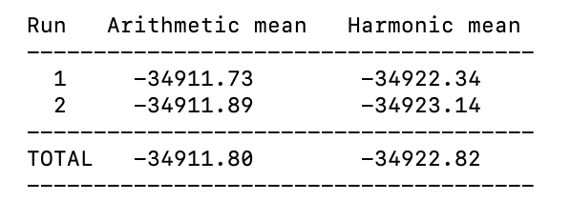
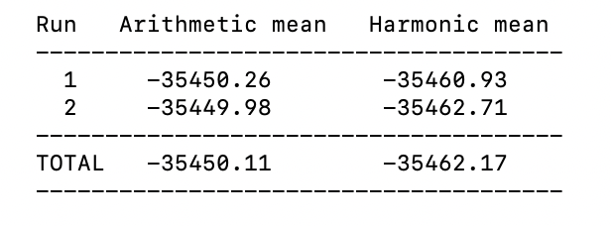
Hypothesis Testing
Table1. Mean values of positive constraint i.e. Homo sapiens and Mus musculus are closely
Table 2. Mean values of negative constraint i.e. Homo sapiens and Mus musculus are not closely related.
Notes:
Positive constraint was set as Homo sapiens’ and Mus musuculus’ ATM sequence being closely related and the negative constraint was that two sequences were not closely related. The log likelihood values generated after setting the two constraints differed each other by 539.35. Using the formula, K = ln[BF(M0,M1)] = ln[P(X | M0)] − ln[P(X | M1)], K = 2.29 and BF = 9.87. Since K >1; we have support for disregarding the negative constraint and stating that the first model, i.e. ATM sequence of Homo sapiens and Mus Musculus are similar.

Slide 13
Conclusions
Maximum likelihood tree showed ATM sequence in Mus Musculus was the second closest to that of a Homo Sapiens.
Bootstrap analysis showed high support for the tree.
Hypothesis testing provided further evidence to support the hypothesis that the two sequences were similar.
Notes:
Since experimental genetics studies in humans are highly restricted due to ethical reasons, model organisms must be used and it is important to pick a model organism which is closely related to humans if the results are to be translated to humans. For this purpose, it is also important to not just look at the phylogenies of the entire genomes of the model organisms, but to dive into the specifics and focus on similarities among the gene sequences. Similarities in the coding sequences of the gene represents functional equivalence and evolutionary relationships between the protein among different species. phylogenetic pattern seen here adds credibility to our studies and provides confidence to be able to hypothesize that the DNA Damage repair pathway that ATM is involved in in Mus musculus is similar to what one might expect in Homo sapiens.
. This alone is not enough evidence to claim that any results obtained about this protein in Mus musculus can now be applied to the function of ATM in Homo sapiens. But until we are able to perform studies directly in Homo sapiens, this result takes us one step closer to making that claim.

Slide 14
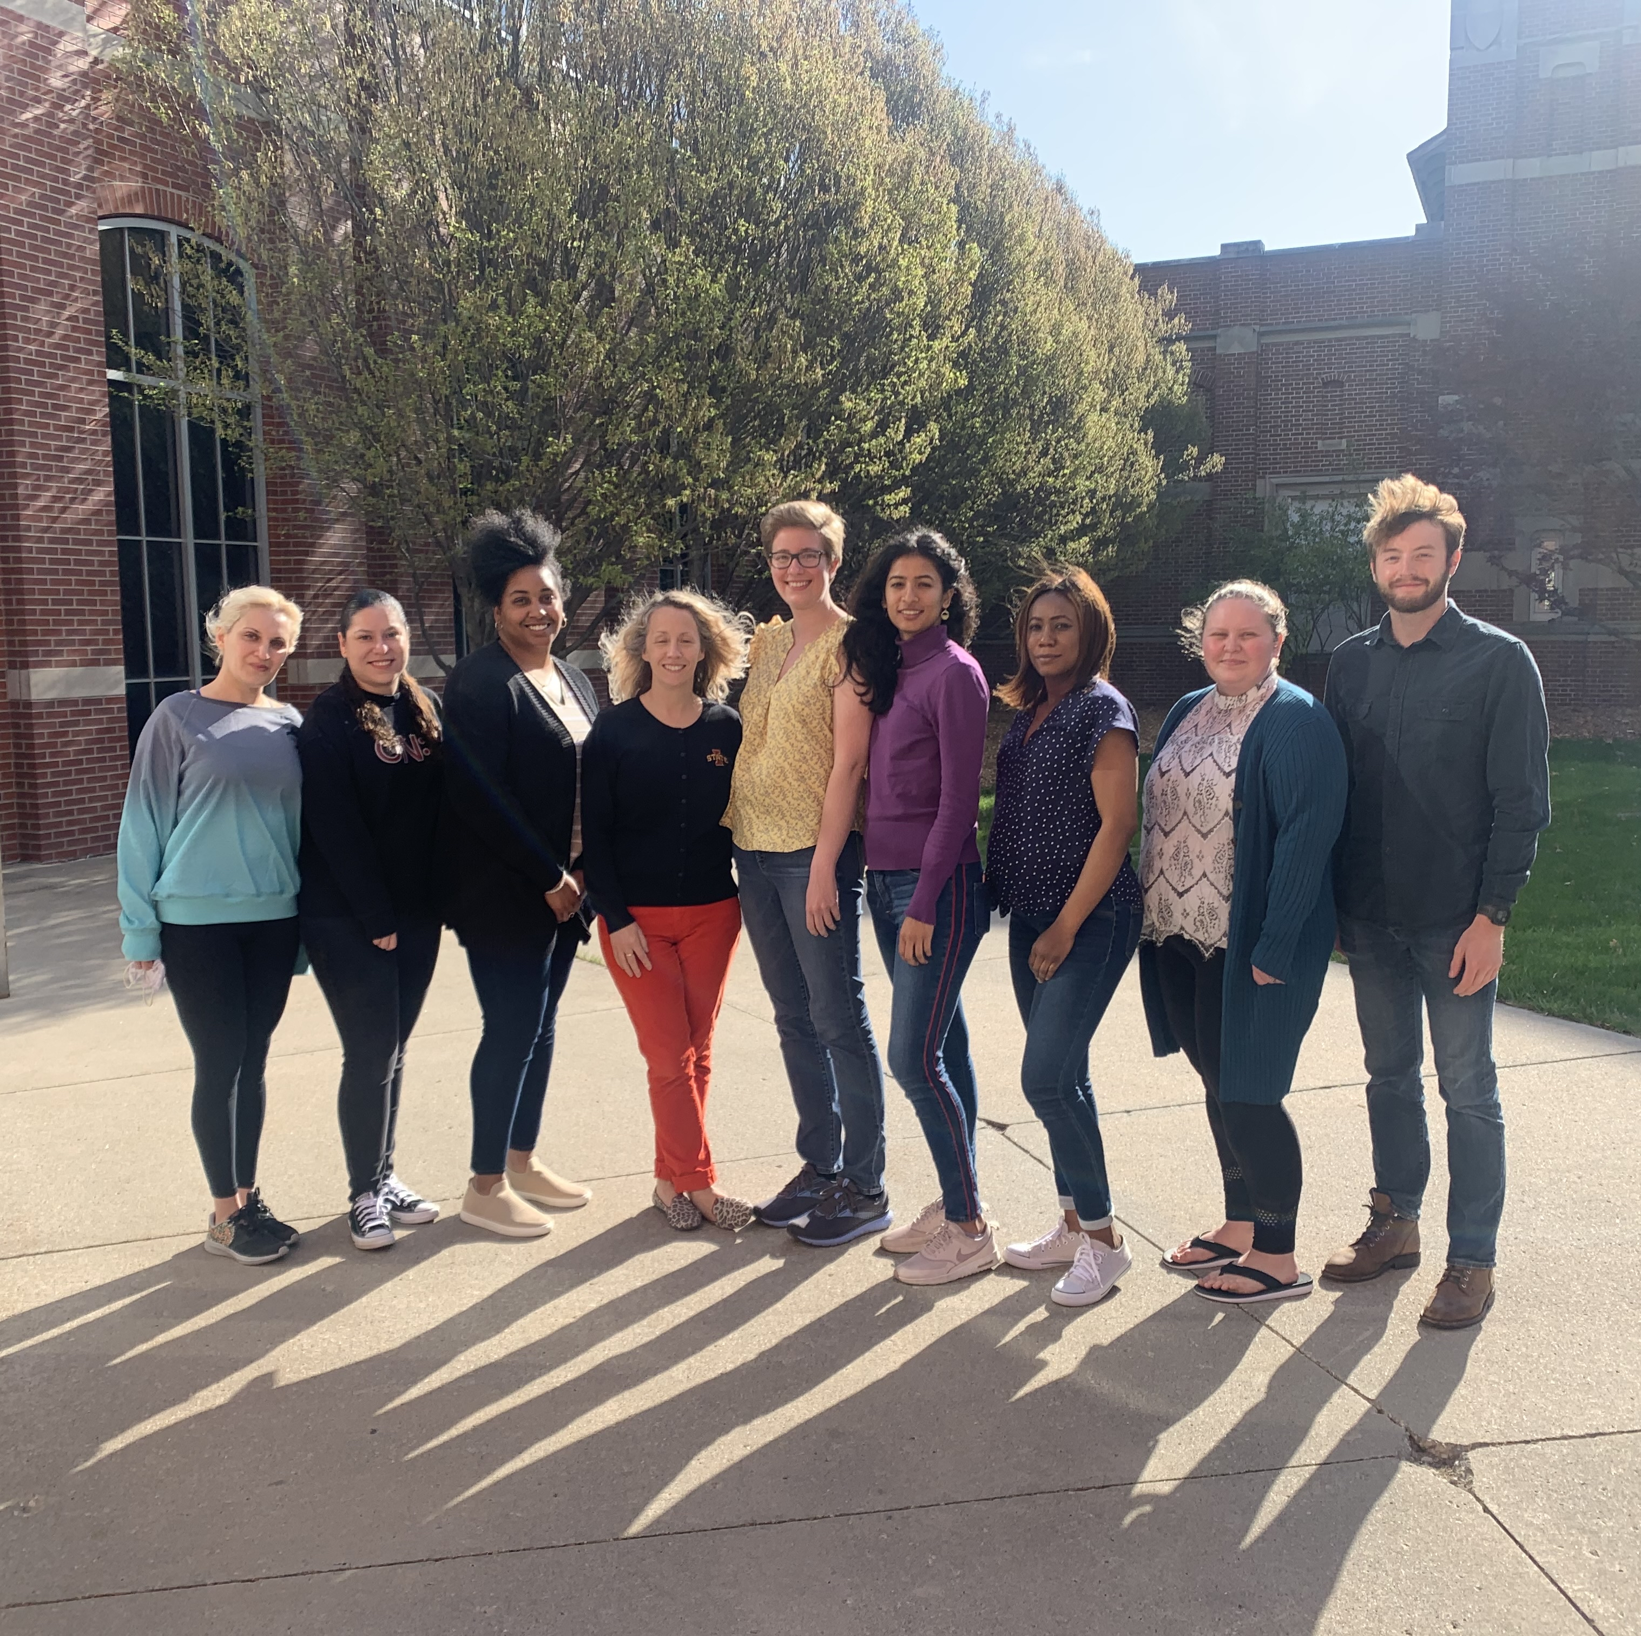
Keating Lab Dr. Dennis Lavrov Fellow classmates
Acknowledgements

